Slide 1
Accuracy %
65%
57%
Original Model Improved Model

Slide 2
Import Libraries
Derive CNN model from TensorFlow and implement using Keras
Plot training and validation loss and accuracy.
Pre-process images using OpenCV
Augment images with Gaussian filter, grayscale conversion, Gaussian blur, and image speckle noise. Use CNN for high-dimensional feature analysis
Augment images using Gaussian filter. Apply image speckle noise and high dimensional feature analysis using CNN.
Apply variable learning rates and use Adam optimizer, binary cross-entropy loss, and accuracy as metrics.
Accurately identifying different types of tumors in MRI scans

Slide 3
Import Libraries
Derive CNN model from TensorFlow and implement using Keras
Plot training and validation loss and accuracy.
Pre-process images using OpenCV
Augment images with Gaussian filter, grayscale conversion, Gaussian blur, and image speckle noise. Use CNN for high-dimensional feature analysis
Augment images using Gaussian filter. Apply image speckle noise and high dimensional feature analysis using CNN.
Apply variable learning rates and use Adam optimizer, binary cross-entropy loss, and accuracy as metrics.
Accurately identifying different types of tumors in MRI scans

Slide 4
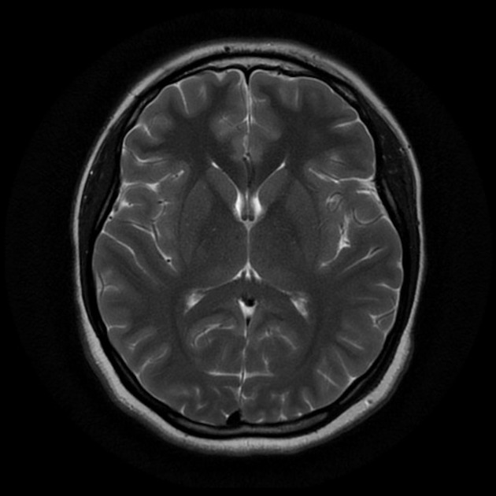
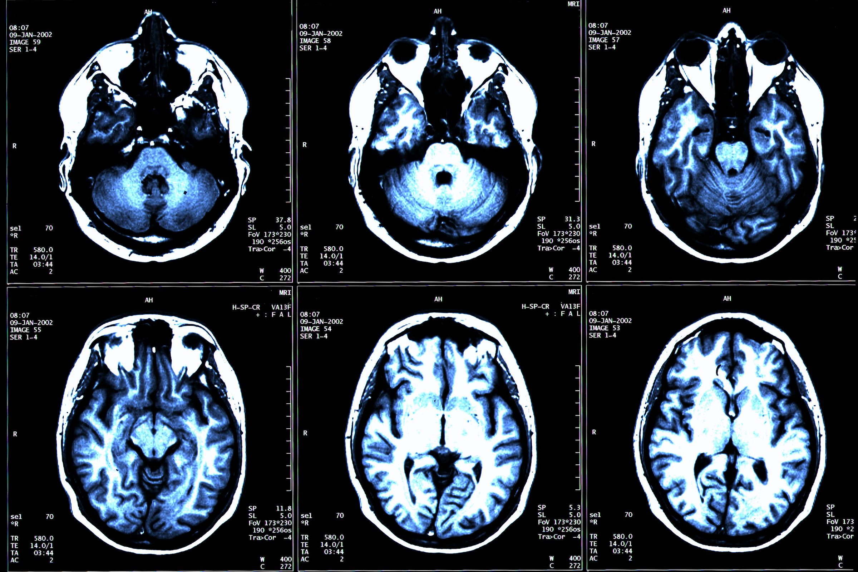
Pituitary
Dataset
.jpg files of 3 classes
Pre-processing
Edge Detection
Training
CNN
Tumour
Model
Glioma
Input Image
.jpg file
Model
Meningioma

